Slide 1
Chapter 10: Biotechnology provides evidence of evolution

Slide 2
10.1 Processing DNA
DNA can be processed by a range of techniques so that it can be analysed and compared for applications such as tracking evolutionary changes.
Polymerase chain reaction and amplifying DNA
The development of the polymerase chain reaction (PCR) has enabled small quantities of DNA to be replicated, producing testable amounts to use in analysis techniques.
PCR mimics the natural process of DNA replication that occurs prior to cell division. During the process, the DNA goes through a series of three steps:
1 Denaturing: The two strands of DNA are separated.
2 Annealing: Short sections of DNA (primers) are bound to the separated strands.
3 Extension: The short sections of DNA are extended to produce longer strands.
This sequence is repeated approximately 20–30 times, in a process called thermocycling. It takes two to three hours to produce about a billion copies of the DNA.

Slide 3
10.1 Processing DNA
Denaturation
During natural DNA replication, the enzyme helicase separates the two strands of DNA, allowing each strand to be copied. The polymerase chain reaction uses heat to achieve the same function. Temperatures of approximately 94–96°C are used to break the hydrogen bonds holding the two strands together. This separates the strands without disrupting each individual strand.

Slide 4
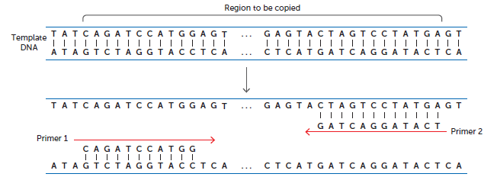
10.1 Processing DNA
Annealing
During the annealing process the temperature is decreased to approximately 50–60°C. This allows short strands of DNA called primers to bind to the single DNA strands. The primers are not random sections of DNA. Instead, they are complementary to either end of the section of DNA to be copied.

Slide 5
10.1 Processing DNA
Extension
The extension step, also known as elongation, also mimics the process of DNA replication. The enzyme DNA polymerase is used to join new, complementary nucleotides to the sections originating with the primers. This extends, or elongates, the nucleotide chain and creates a new strand of DNA. However, it is not the full length of the original DNA, as it starts at the primer and not at the end of the DNA. Eventually, the majority of DNA strands are the length of DNA between the location of the primers.
DNA polymerase attaches to double-stranded DNA. Prior to the extension step, this only occurs where the primers are located. Therefore, the primers act as a starting point and, hence, initiate DNA replication.

Slide 6
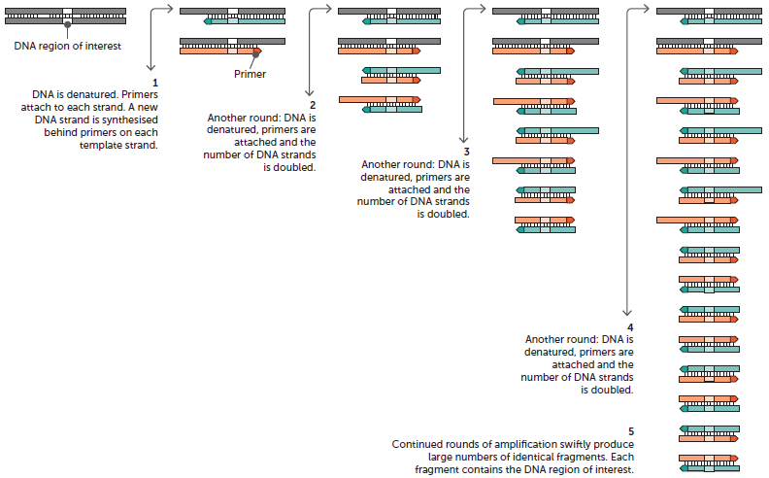
10.1 Processing DNA
A diagrammatic representation of the polymerase chain reaction

Slide 7
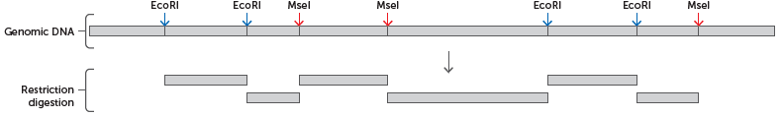
10.1 Processing DNA
Gel electrophoresis and DNA profiling
When restriction enzymes are added to DNA, it cuts the strands into different lengths depending on the base sequence of the specific DNA sample. The length of these pieces can be analysed and compared with other DNA samples.
DNA cut with the restriction enzymes EcoRI and MseI producing pieces of different lengths

Slide 8
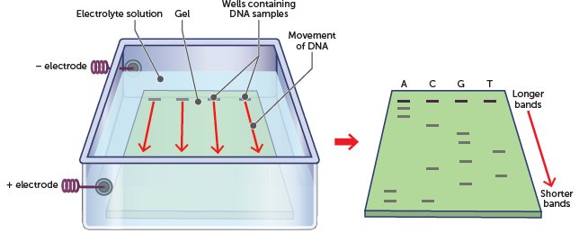
10.1 Processing DNA
Gel electrophoresis is a technique that is able to separate DNA strands based on their lengths. The DNA pieces are placed in wells in a semi-solid gel that is immersed in a solution of an electrolyte. There are electrodes at either end of the gel. The negative electrode is closest to the DNA and the positive electrode is at the opposite side. When an electric current is passed through the gel, the negatively charged DNA moves towards the positive electrode. The smaller DNA pieces move faster than the larger ones and so are located further away from the negative electrode when the current is stopped. This results in a pattern of bands that looks similar to the barcodes on products sold in supermarkets. This banding pattern is an individual’s DNA profile, often called a DNA fingerprint.

Slide 9
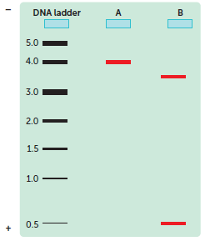
10.1 Processing DNA
Filling the wells
The wells where the DNA is placed are simply depressions in the gel. This means that, when the current is applied, the DNA will move through the gel rather than diffuse through the solution. Therefore, for gel electrophoresis to work effectively the DNA needs to be accurately placed in the wells. This is typically done using a micropipette. Micropipettes have disposable tips at the end that can be put on and off the pipette without any contact, reducing any chance of cross-contamination.
DNA ladders
A DNA ladder is often ‘run’ at the same time as the samples. The ladder contains segments of DNA with known lengths. The results from the unknown sample are compared to the ladder to determine the length of the DNA strands in the sample.

Slide 10
10.1 Processing DNA
Visualising DNA
After the DNA strands are separated, scientists use different methods to visualise the DNA. Ethidium bromide can be added to the agar prior to the gel being set. As the DNA moves through the gel it picks up some of the chemical. Upon completion of the ‘run’, a special ultraviolet light is shone over the gel and the DNA fluoresce. Ethidium bromide is a carcinogen and, therefore, must be handled very carefully.
Methylene blue is a dye that binds to DNA. When the gel is soaked in the dye, the areas containing DNA stain a deeper blue and are therefore visible to the naked eye. Another method is the use of DNA probes. These are short sections of a single strand of DNA with a radioactive or fluorescent molecule that binds to the DNA being tested.

Slide 11
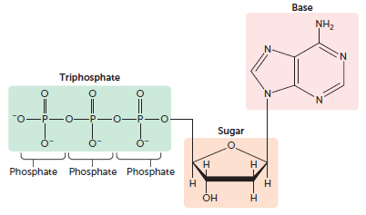
10.1 Processing DNA
DNA sequencing
DNA sequencing is the determination of the precise order of nucleotides in a sample of DNA. The Sanger method is the most frequently used.
DNA is synthesised from four nucleotides, each with a different nitrogenous base – adenine, cytosine, guanine or thymine. Nucleotides are more correctly called deoxynucleotide triphosphates, as they consist of three phosphate groups joined to the sugar deoxyribose with its base.
When DNA forms:
each nucleotide loses two phosphate groups
the sugar molecule loses a hydrogen atom from the hydroxy group (OH) when it bonds to the phosphate group of an adjacent nucleotide.

Slide 12
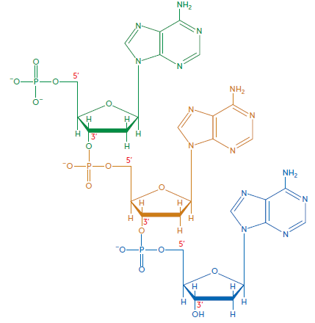
10.1 Processing DNA
Three nucleotides joined together in a section of DNA

Slide 13
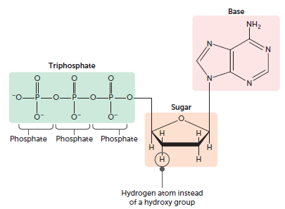
10.1 Processing DNA
In Sanger’s method, synthetic nucleotides that lack the OH group are added to the growing strand. These are called dideoxyribonucleotide triphosphates, or dideoxyribonucleotides (ddNTPs).
The synthetic nucleotide stops the elongation of the sequence because there is no OH group for the next nucleotide to attach to. This happens at each of the nucleotides in the DNA sample, creating different lengths of DNA. These can be separated using gel electrophoresis. Knowing which base was added to create each length allows scientists to determine the order of nucleotides.

Slide 14
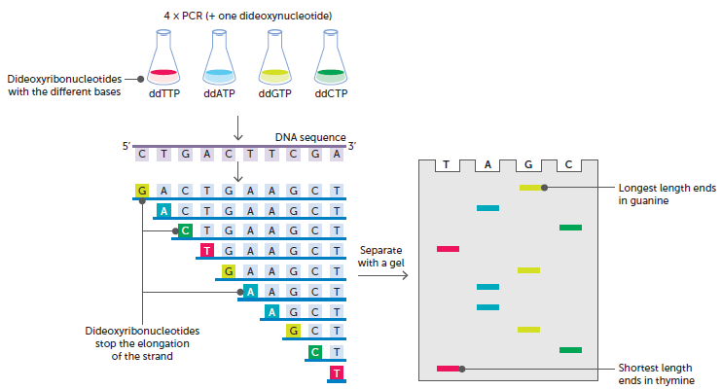
10.1 Processing DNA
DNA sequencing using Sanger’s method

Slide 15
10.1 Processing DNA
DNA sequencing can be used to identify mutations or to compare DNA from different organisms.
This is useful in identifying inherited disorders such as sickle-cell anaemia, cystic fibrosis and some forms of cancer. It has also been used for maternity and paternity tests, in cases where the identity of the father or mother of a child is in dispute. DNA sequencing can be used by scientists to compare species in order to track evolutionary changes.

Slide 16
10.1 Processing DNA
Ethical considerations with genetic information
The following principles must be respected when obtaining genetic information:
Autonomy: respect for the right to be self-determining and to choose whether or not to be tested and, if tested, to know and share the information. It also includes the right of an individual to decide their own future, independent of genetic information.
Confidentiality: the use of genetic information is treated sensitively, and is accessed only by those who are authorised to access it.
Equity: the right to fair and equal treatment regardless of genetic information.
Privacy: the right to be ‘left alone’ and to make decisions regarding genetic testing and the resulting information, independent of others.

Slide 17
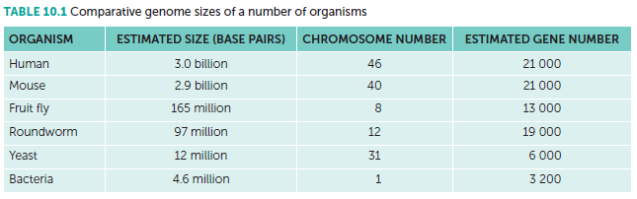
10.2 DNA provides evidence of evolution
Comparative genomics
The complete set of DNA in each cell of an organism is called the genome. Comparative genomics is a relatively new field of biological research in which the genome sequences of different species are compared. By comparing the sequence of the human genome with genomes of other organisms, researchers are able to identify regions of similarity and difference. This procedure provides an effective means of studying evolutionary changes among organisms, helping to identify genes that are preserved among species, as well as genes that give each organism its unique characteristics.

Slide 18
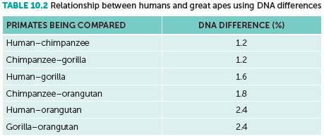
10.2 DNA provides evidence of evolution
Comparative genomics has revealed a high level of similarity between closely related organisms such as humans and chimpanzees. It has also been used to reveal the diversity of gene composition in different evolutionary lineages. Such research may result in a rearrangement of the way we view some of the evolutionary relationships between primates.
Examination of the genome of our closest living relatives, the chimpanzees, shows that they share more than 98% of our DNA.

Slide 19
10.2 DNA provides evidence of evolution
Endogenous retroviruses (ERVs)
In addition to the genes coding for proteins, chromosomes also contain some non-coding sequences of bases in the DNA. These sequences are sometimes referred to as ‘junk DNA’ as they have no apparent function and appear to serve no purpose. Comparisons of junk DNA provide similar results as those for other parts of the genome: more closely related species have more junk sequences in common. This observation only makes sense if related species have evolved from a common ancestor.
An ERV is a viral sequence that has become part of an organism’s genome. Retroviruses store their genetic information as RNA, not DNA. Upon entering a cell, a retrovirus copies its RNA genome into DNA in a process known as reverse transcription. The DNA then becomes inserted into one of the host cell’s chromosomes. A retrovirus only becomes endogenous if it inserts into a cell whose chromosomes will be inherited by the next generation, an ovum or a sperm cell. The offspring of the infected individual will then have a copy of the ERV in the same place, in the same chromosome, in every single one of their cells. All subsequent generations will also have a copy of the ERV at the same location. What scientists have found is that ERVs make up 8% of the human genome, and that other primates also possess some of the same ERVs in exactly the same locations in their genomes.

Slide 20
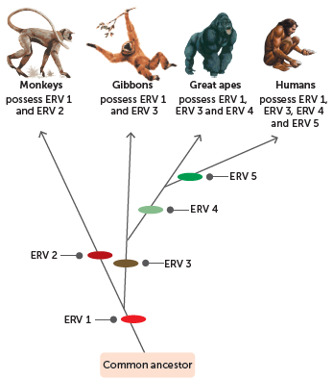
10.2 DNA provides evidence of evolution
When comparing the chromosomes of humans and chimpanzees, it has been discovered that the same ERVs are located in the short arm of chromosome 10, the short arm of chromosome 1, the long arm of chromosome 9 and the short arm of chromosome 6 for both species. In all, scientists have found 16 instances of human ERVs matching exactly with chimpanzee ERVs. This is compelling evidence that humans and chimpanzees share a common ancestor.
Any retrovirus that became inserted into the genome of a common ancestor would be inherited by both chimpanzees and humans at exactly the same location in the chromosome.

Slide 21
10.2 DNA provides evidence of evolution
Mitochondrial DNA
Mitochondria are the organelles in the cell where the aerobic phase of respiration occurs to release energy for use by the cell. Most of a cell’s DNA is located in the nucleus, but a small amount is in the mitochondria. This is called mitochondrial DNA, or mtDNA.
mtDNA is in the form of small circular molecules. There are about five to ten of these molecules in each mitochondrion. Mitochondrial DNA has 37 genes, all of which are essential for the mitochondrion to function normally. Twenty-four of the genes contain the code for making transfer RNA molecules, which are involved in protein synthesis. The other 13 genes have instructions for making some of the enzymes necessary for the reactions of cellular respiration.
Most cells contain large numbers of mitochondria and therefore usually have between 500 and 1000 copies of the mtDNA molecule. This makes it a lot easier to find and extract than the DNA in the nucleus, and so smaller samples can be used. In humans, the mtDNA genome consists of about 16 500 base pairs, representing only a fraction of the total amount of DNA in a cell.

Slide 22
10.2 DNA provides evidence of evolution
Inheritance of mitochondrial DNA
Human eggs and sperm both have mitochondria, but while an egg has many hundreds, a sperm has only about 100, just enough to provide the energy for the sperm to swim to the egg. After a sperm has penetrated the egg at fertilisation, the mitochondria in the sperm are rapidly destroyed. This means that, while our nuclear DNA comes from the nucleus of the egg and the sperm, our mitochondrial DNA comes only from the egg. In other words, we inherit nuclear DNA from both parents, but we inherit mitochondrial DNA only from our mothers.

Slide 23
10.2 DNA provides evidence of evolution
Evidence from mitochondrial DNA
DNA found in the mitochondria has a higher rate of mutation than nuclear DNA. Because of these mutations, human mtDNA has been slowly diverging from the mtDNA of our original female ancestor, and the amount of mutation is roughly proportional to the amount of time that has passed. Scientists are able to use the similarity between the mtDNA of any two individuals to provide an estimate of the closeness of their relationship through their maternal ancestors. If their mtDNA is identical they will be closely related, perhaps even siblings. On the other hand, if the mtDNA is very different, their last common maternal ancestor lived long ago. The use of mtDNA has been found to be of most value when comparing individuals within a species and for species that are closely related. In this way, it has allowed scientists to track the ancestry of many species back hundreds of generations.

Slide 24
10.3 Other biochemical evidence
Protein sequences
Comparative protein studies also provide evidence for evolution. Proteins consist of long chains of particular amino acids linked together in a precise sequence determined by the DNA. There are tens of thousands of types of proteins in living things and all are fabricated from 20 kinds of amino acids.
Modern biochemical techniques enable the sequence of amino acids in a protein to be determined. By comparing the type and sequence of amino acids in similar proteins from different species, the degree of similarity can be established. Animals of the same species have identical amino acid sequences in their proteins, and those from different species have different amino acids or they are arranged in a different order. Just like DNA analysis, the degree of difference between proteins enables an estimate to be made of the amount of evolution that has taken place since two species developed from a common ancestor. The longer the period of time involved, the greater the number of amino acids that are different.

Slide 25
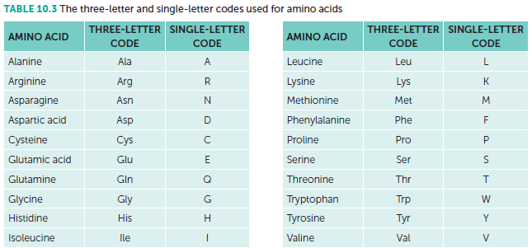
10.3 Other biochemical evidence
Amino acids are usually represented by a three-letter code, frequently the first three letters of their name. To make comparison of amino acid chains easier, scientists have also adopted a system of coding whereby one letter is used to represent one particular amino acid. By listing the amino acids for a particular protein in sequence, a comparison can be made with other species. This has been done for a number of proteins that appear to be in all species and which are referred to as ubiquitous proteins. Such proteins perform very basic, but essential, tasks that all organisms require for life.

Slide 26
10.3 Other biochemical evidence
Cytochrome C is a well-researched example of a ubiquitous protein that shows how protein sequences can provide evidence for evolution. This protein performs an essential step in the production of cellular energy. It appears to have changed very little over millions of years of evolution.
Human cytochrome C contains 104 amino acids. Regardless of the species tested, 37 of these have been found at the same positions in every sequenced cytochrome C molecule. This strongly suggests that these proteins have descended from an ancestral cytochrome C molecule found in a primitive microbe that existed more than 2000 million years ago.
To compare cytochrome C sequences, they need to be aligned so that the maximum number of positions containing the same amino acids can be determined. The more similarity there is between two molecules, the more recently they have evolved from a common ancestor. By doing such comparisons, scientists have determined that the cytochrome C of chimpanzees and gorillas is the same as that for humans, and for rhesus monkeys it differs by only one amino acid compared with that of humans.

Slide 27
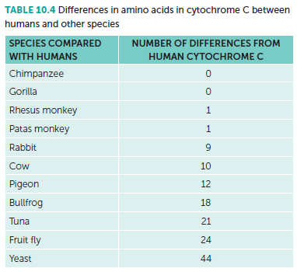
10.3 Other biochemical evidence

Slide 28
10.3 Other biochemical evidence
Bioinformatics
Bioinformatics is the use of computers to describe the molecular components of living things. It uses biochemical analysis to gain information about DNA and proteins, and computer software to store and analyse it.
Bioinformatics has been particularly useful in assisting evolutionary biologists to trace the evolution of a large number of organisms by measuring changes in their DNA, rather than through traditional techniques of physical taxonomy or physiological observations. The more similar the genes of two species, the closer their evolutionary relationship.
More recent developments have enabled researchers to compare entire genomes. In doing so, the genes and other biological features in a DNA sequence need to be identified, in a process termed annotation. This process needs to be computerised, as most genomes are far too large to be annotated by hand. Annotation is made possible by the fact that genes have recognisable start and stop codons.

